Slide 1
Innovative Herbal Insights into Autoimmune Disease
Lee W Carroll B.Sc.

Slide 2
Autoimmune Diseases
It is just over 100 years since the first autoimmune disease was described and in that time the list of autoimmune diseases has steadily grown
It is estimated that approximately 5% of the world’s population have an autoimmune disease
Autoimmune diseases affect almost every major organ of the body
Understanding the precise aetiology of autoimmunity remains an important challenge for health research
Zouali M. Molecular Autoimmunity. Springer Sciences+Business Media. New York USA. 2005

Slide 3
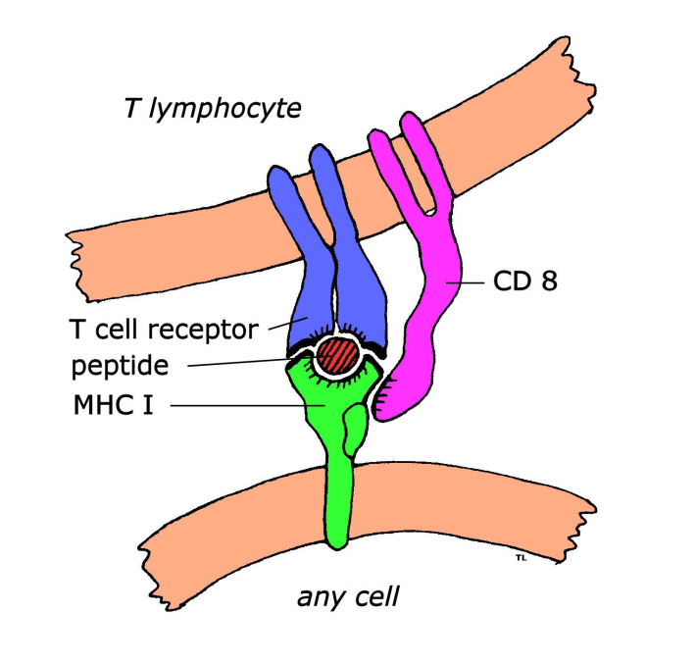
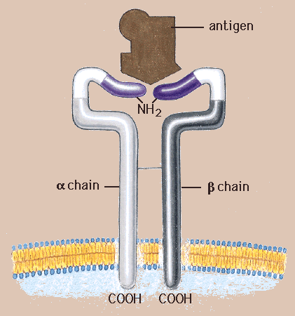
Self Recognition
Is a normal function of the immune system
Autoreactive B- and T-cells are produced naturally without destructive disease
So autoimmune disease is not some inbuilt defect in the hardware or software of the immune system

Slide 4
AID Progression
1. Genetic susceptibility
2. Trigger
3. Autoimmunity preceding clinical manifestations
4. Overt disease
Kronenbert, Melmed, Polonski, Larsen Editors. Williams Textbook of Endocrinology. Saunders Elsevier, Philadelphia USA. 2008. p1749

Slide 5
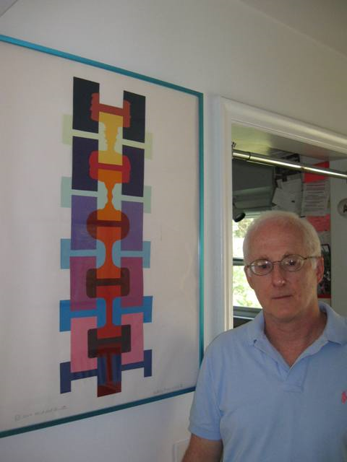
The Dual Signal Hypothesis
The primary lesion
AND
Immune system dysregulation
Westall FC, Root-Bernstein R. Lancet 1986; 2(8501): 251-252

Slide 6
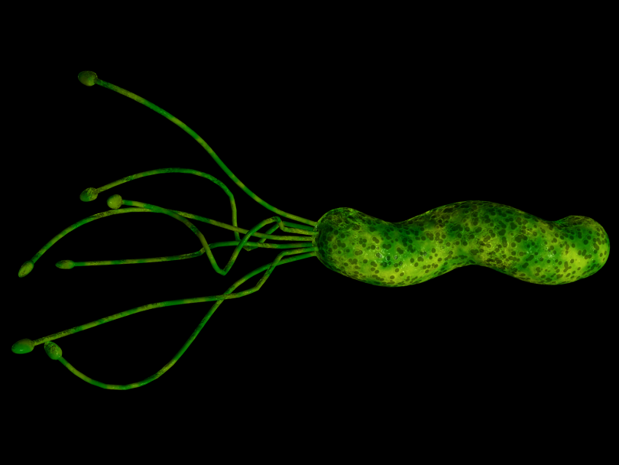
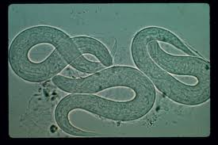
The Primary Lesion
The drive to react to self and can be caused by:
  Infection
  Infestation
  Chronic tissue destruction or excessive apoptosis

Slide 7
Immune System Dysregulation
A state of immune hyper-reactivity or imbalance and can be caused by:
  Infection, infestation, endotoxemia
  Allergy or chemical sensitivity
  Diet
  Genetic factors
  Injury or foreign body
  Vaccination
  Stress

Slide 8
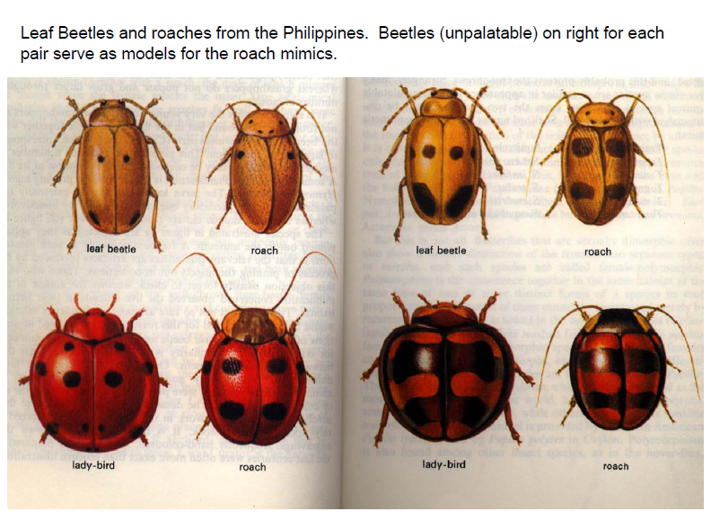
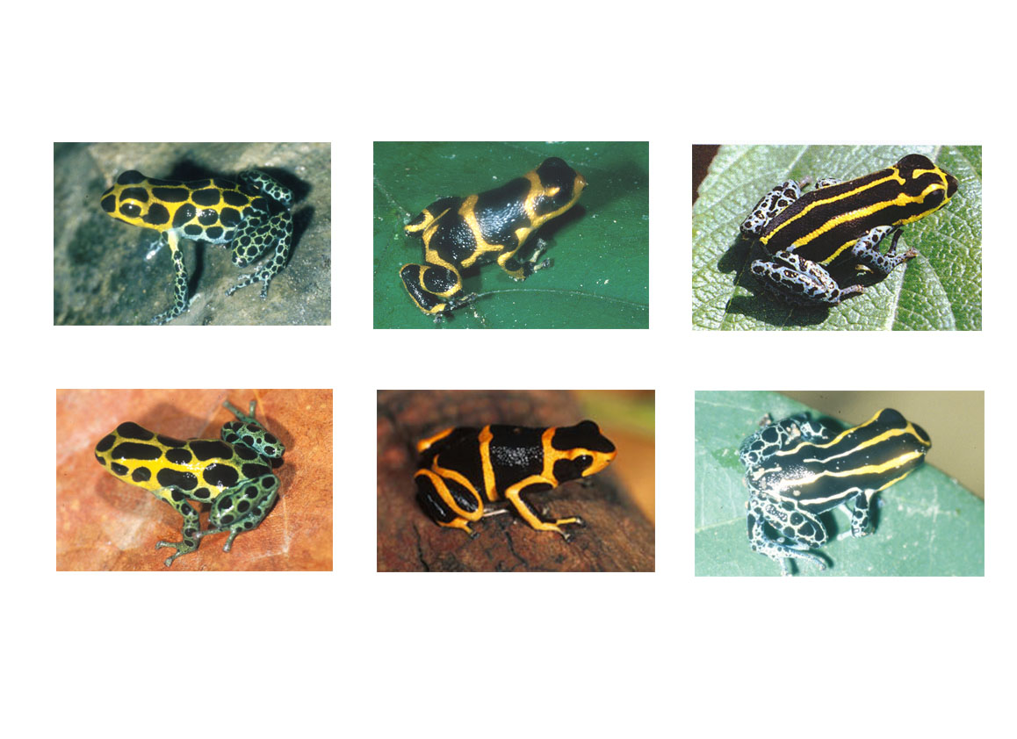
Mimicry in Nature
Notes:
Beetles unpalatable to birds
Roaches mimic beetles so not to be eaten

Slide 9
Molecular Mimicry
Molecular mimicry (MM) explains the similarity between amino acid sequences of surface proteins on pathogens and host proteins
Pathogens mimic host proteins to be viewed as ‘self’ by the host immune system and avoid detection
Evidence showing an association between infectious agents and the presence of autoimmune disease and an observed cross-reactivity of self antigens with microbial determinants
Oldstone, M.B. Molecular mimicry and autoimmune disease, Cell, 1987;50(6): 819-820
Albert, L.J., Inman, R.D. Molecular mimicry and autoimmunity, NEJM, 1999;341(27): 2068-2074
Liang B, Mamula MJ. Cell. Mol. Life Sci. 2000; 57: 561-568

Slide 10
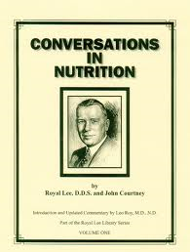
Royal Lee and Autoimmunity
“From these considerations, it seems entirely possible that certain human diseases have as their basis an immunological reaction to host tissues made antigenic by infectious processes”
Dr Royal Lee, quoting Peterson and Good,
in his lecture on Allergies as a Cause of Disease,
Exogenous and Endogenous Antigenic
Immune and Autoimmune Reactions:
Cause and Correction.
May 7, 1963

Slide 11
Notes:
A= Alanine
Q=Glutamine
G= Glycine
A= Alanine
P=Proline

Slide 12
Poliovirus VP2 STTKESRGTT
Acetylcholine receptor TVIKESRGTK
Papilloma virus E2 SLHLESLKDS
Insulin receptor VYGLESLKDL
Rabies virus glycoprotein TKESLVIIS
Insulin receptor NKESLVISE
Klebsiella pneumoniae nitrogenase SRQTDREDE
HLA B27 KAQTDREDL
HIV p24 GVETTTPS
Human IgG GVETTTPS
Measles virus P3 EISDNLGQE
Myelin basic protein EISFKLGQE
Adenovirus 12 E1B GMFRPSQCN
Gliadin GSFRPSQQN

Slide 13
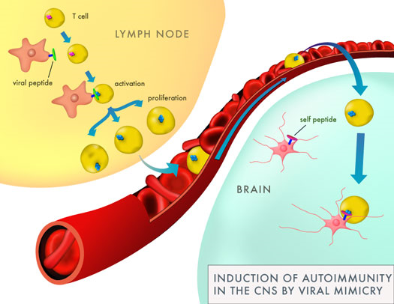

Slide 14
Pathogen-Triggered AID
Ankylosing Spondylitis
Rheumatoid Arthritis
Crohn’s Disease
Ulcerative Colitis
Systemic Lupus Erythematosus
Multiple Sclerosis
HIV AIDs
Myasthenia Gravis
Graves Disease
Type 1 Diabetes
Addison’s Disease
Guillain-Barré syndrome
Scleroderma
Idiopathic
thrombocytopenic
purpura
Chronic active hepatitis

Slide 15
Setting the Scene
Develop a systematic approach to defining the key causative and sustaining factors operating
For each individual the autoimmune process has been precipitated by a unique and complex interaction of causative events
A multi-factorial model to individualize treatment and take into account both on the individual’s story and the research which identifies the likely causative factors for each disease

Slide 16
The Aims of Herbal Support
Neutralizing the source of the disease cascade
Predisposing factors must be addressed, together with any precipitating factors which are still thought to be relevant to the case
Controlling the inflammation as a perpetuating factor
Downregulating immunological memory (if relevant)
Addressing all other relevant exacerbating/ perpetuating factors
Notes:
Need to address the causes
Predisposing causes
Excitatory or precipitating causes
Perpetuating or sustaining causes

Slide 17

Treatment of AID
General Considerations
Case history – individualized
Patient Constitution
Etiological models for specific disorders
Diet

Slide 18
1. Treatment Strategy
Clear pathogens: Antiviral, antibacterial, antifungal, antiprotozoal, anthelmintic
Gut Flora Complex (antibacterial, antifungal, antiprotozoal)
St John’s Wort 1.8g (antiviral)
Andrographis Complex (antiviral)
Cranberry Complex (antibacterial)
Wormwood Complex (anthelmintic)
Garlic 5000mg (antibacterial)
Golden Seal 500mg (antibacterial)

Slide 19
2. Treatment Strategy
Treat Dysbiosis
Dysbiosis is a state of disordered microbial ecology that can cause disease and thru MM lead to development of autoimmune disease
Reduce unhealthy or pathogenic flora using antibacterial/fungal herbs
Encourage healthy gut flora through soluble fiber in diet and supplementation, supported by probiotics
Reduce starch and sugar in diet

Slide 20
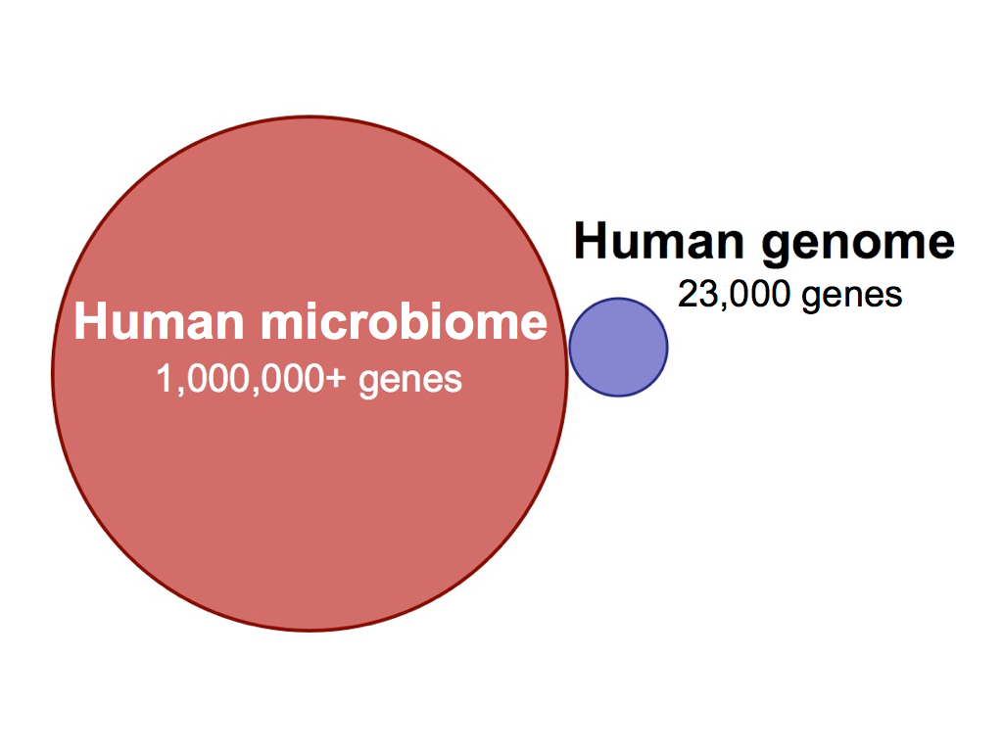

Slide 21
GI Flora Balance Protocol
Everyday for 6 to 10 weeks
Gut Flora Complex, 1 capsule twice per day
Prebiotic Inulin, 1/2 to 1 teaspoon twice per day
Or
Wholefood Fibre or Gastro Fibre
If required include,
Vitanox, 2 to 3 tablets per day
ProSynbiotic, 3 capsules per day
Repeat as required

Slide 22
3. Treatment Strategy
Immune Supporting Herbs
To resolve infection and help with immune system regulation. This is a controversial area but I have never found herbs to aggravate an autoimmune disease
Echinacea Premium
Andrographis Complex
Astragalus Complex
Eleuthero
Cat’s Claw Forte

Slide 23
Echinacea and Heat Shock Proteins
Human studies show that Echinacea Premium taken at 2 tablets per day for 2 weeks increases:
  Heat shock proteins (HSP) in white blood cells
    62% in males
    36% in females
  White blood cells counts approx 10% (NK cells
  and monocytes)
Agnew LL, Guffogg SP, Matthias A, Bone KM et al. Echinacea intake induces an immune response through altered expression of leukocyte hsp70, increased white cell counts and improved erythrocyte antioxidant defences. J Clin Pharm Ther 2005; 30(4), 363-369

Slide 24
Heat Shock Proteins
Regulate immune system function
  Immune cell activation
  Antigen presentation
  Stressed or damaged cell recognition
  Tumor recognition
  Activation of complement cascade

Slide 25
4. Treatment Strategy
Modulate Immune Function
To downregulate immunological memory
Rehmannia Complex is the key formula.
  Rehmannia
  Bupleurum
  Hemidesmus
  Feverfew
Hemidesmus downregulates T and B cells
Protomorphogens

Slide 26
5. Treatment Strategy
Support the Organs Related to the Primary Lesion
If prostatitis as in ankylosing spondylitis is identified give Nettle Root or Saw Palmetto (ProstaCo) as well as UT antiseptics (Cranberry Complex)
If a UT infection, use Licorice, Crataeva (bladder) and UT demulcents (Adrenal Complex, Cranberry Complex)

Slide 27
5. Treatment Strategy
Support the Organs Related to the Primary Lesion
If liver, give hepatic trophorestoratives eg, Milk Thistle (Silymarin)
If chronic sinusitis, give anticatarrhal herbs eg Eyebright and mucous membrane tropho-restoratives eg Golden Seal, (Euphrasia Complex)
Use relevant protomorphogens
Notes:
Licorice adrenals
Rehmannia Kidney
St John’s Wort/Ginkgo Nerves/Brain

Slide 28
6. Treatment Strategy
Treat a Toxic State
Remove source eg dental amalgam
Herbs to support liver and heavy metal detoxification
ChelaCo
Silymarin
Garlic 5000mg
LivCo

Slide 29
7. Treatment Strategy
Treat Leaky Gut Wall
Demulcents and healing herbs eg HiPep and gotu Kola Complex tablets
Improve phagocytosis and hepatic screening eg Echinacea Premium and Silymarin tablets
Remove allergens
Treat dysbiosis as discussed

Slide 30
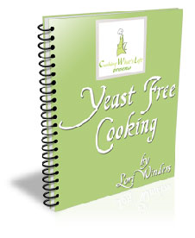


8. Treatment Strategy
Diet
Eliminate major antigens: dairy, wheat (gluten), yeast, egg
Fish oil supplementation helps RA and IBD
Dairy-free and low starch diets help AS (see later)
Low sulfur diet helps UC (see later)

Slide 31
9. Treatment Strategy
Symptomatic Treatment
Generalized Anti-inflammatory Herbs
“Steroid-like” – Rehmannia Complex, Adrenal Complex
“Non-steroid-like” – Boswellia Complex
Feverfew in Rehmannia Complex – inhibits inflammatory degranulation of polymorphs
Boswellia in Boswellia Complex has significant anti-inflammatory effects in IBD, eg, Crohn’s disease and Ulcerative colitis

Slide 32
10. Treatment Strategy
Symptomatic Treatment
Specific related to the pathological process or affected organs
Chamomile in inflammatory bowel disease (Hipep)
Ginkgo in MS (Ginkgo Forte, HerbaVital)
Grapeseed extract in MS (Vitanox)
Gymnema in diabetes (Gymnema 4g)
Antisclerosing herbs eg Gotu Kola in systemic sclerosis (Gotu Kola Complex)

Slide 33
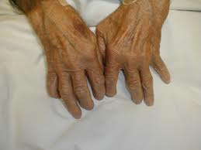
RA: A Coherent Model
The primary lesion is either provided by a bacterium, typically Proteus or a virus, typically EBV
Mycoplasma contribute to immune dysregulation and may even provide the primary lesion in some cases
Diet and intestinal dysbiosis contribute to the immune dysregulation
Hormonal factors play a role in the
immune dysregulation

Slide 34
RA: Treatment Strategy
Immune supporting herbs to help fight the implicated bacteria, viruses and mycoplasma
Antiviral herbs, especially St John’s Wort
Urinary tract antiseptics and bladder support if Proteus is involved eg Cranberry, Crataeva, Buchu
Herbs to regulate intestinal dysbiosis eg Anise and Oregano essential oil, Garlic, Golden Seal, Grape Seed
Herbs to regulate immune function and allay inflammation eg Rehmannia, Hemidesmus, Echinacea, Cat’s Claw

Slide 35
RA Protocol
Core Support
Rehmannia Complex tablets (3-4 per day)
AND
Echinacea Premium tablets (2 per day)
AND
Boswellia Complex tablets (3-4 per day)
AND
The Bowel Flora Protocol for at least 6 to 10 weeks

Slide 36
Andrographis and RA
60 patients with active RA received 170 mg Andrographis (30% andrographolides) 3 times a day for 14 weeks or placebo, after a 2-week washout period
The intensity of joint pain ↓ in the active group, although not statistically significant
Improvement in tender joints, swollen joints was statistically significant
There was a reduction in rheumatoid factor
Burgos RA, etal, Efficacy of an Andrographis paniculata composition for the relief of rheumatoid arthritis symptoms: a prospective randomized placebo-controlled trial. Clin Rheumatol. 2009 Aug;28(8):931-46. Epub 2009 Apr 29

Slide 37
Additional Support (as required)
Cranberry Complex tablets (3-4 per day chronic,
6-8 per day acute) for Proteus
St John’s Wort tablets (3-4 per day) for antiviral support
Cat’s Claw Forte tablets (3-4 per day) for added immune support
Gotu Kola Complex (3-4 per day) for added joint support
Andrographis Complex (4-6 per day)

Slide 38
Additional Support (as required)
Rumaplex (6 to 9 per day)
Tuna Omega-3 (2 to 4 per day)
A 7 to 10 day fast followed by either a low antigenic or vegetarian diet
Olive oil, Cranberry juice and oil-rich fish on a regular basis

Slide 39
AS: A Coherent Model
Klebsiella or some other gut pathogen usually provides the primary lesion and remains present throughout the disease
An associated chronic prostatitis (pathogen unknown) in men or chronic UTI (Chlamydia) in women contributes to the immune dysregulation and may even provide the primary lesion in some cases
Diet (dairy protein) probably contributes to the immune dysregulation
Chronic gut inflammation and intestinal dysbiosis contribute to the immune dysregulation

Slide 40
AS Protocol
Begin treatment with the Gut Flora Protocol
Rehmannia Complex (2 to 4 per day)
Boswellia Complex tablets (3-4 per day)
Echinacea Premium tablets (2-3 per day)
Ligaplex II (3 to 9 per day)
Low starch diet

Slide 41
AS Additional Support
Cranberry Complex tablets (3-4 per day chronic,
6-8 per day acute) for urinary tract infection and prostatis
Prostaco capsules (2-3 per day) for prostatitis and Andrographis complex tablets (4-8 per day if acute)

Slide 42
CD: A Coherent Model
The primary lesion is typically caused by MAP, but may be some other gut pathogen
AIEC or another commensal gut organism is a common source of immune dysregulation, which is further exacerbated by the leaky gut and potential endotoxemia which those micro-organism can create
Intestinal dysbiosis in general further adds to the immune dysregulation
Dietary antigens, particularly yeast, contribute further to the immune dysregulation
  MAP = Mycobacterium avium subspecies paratuberculosis
  AIEC = adherent-invasive Escherichia coli

Slide 43
CD Protocol
Begin treatment with the Gut Flora Protocol for 6 to 10 weeks followed by regular use of Golden Seal tablets (3 per day) and Vitanox tablets (2 per day at a separate time to the Golden Seal)
Boswellia Complex (3 to 4 per day)
Echinacea Premium (2 to 3 per day)
Gotu kola Complex (3 to 4 per day)
Okra Pepsin E₃ (2 to 6 per day)
Gastrex (1 capsule before meals)
Low allergenic diet, yeast & dairy free

Slide 44
CD Additional Support
HiPep tablets (3-4 per day) to further allay gastrointestinal inflammation and heal a leaky gut
As the patient recovers there is probably less need for the Rehmannia Complex tablets and the emphasis should move to continued antimicrobial therapy

Slide 45
Hashimoto’s Thyroiditis
Rehmannia Complex tablets (3 to 4 per day)
Echinacea Premium tablets (2 to 3 per day)
Thyroid Complex tablets (2 to 4 per day)
Coleus Forte (2 to 3 per day)
Gotu Kola Complex (3 to 4 per day)

Slide 46
Thankyou
Special thanks to Associate Professor Kerry Bone, Berris Burgoyne and Rob Santich for their contributions to this material

Slide 47
Appendix
Low Antigenic Diet
Low Starch Diet
Ulcerative Colitis

Slide 48
Low Antigenic Diet
Dietary proteins which are difficult to digest have the potential to become antigens which can elicit or derange immune function
Cow’s milk products contain casein and
β-lactoglobulin which fall into this category
Gluten from wheat is notorious for disturbing gut immunological function (as in celiac disease)
Yeast contains proteins and cell wall fragments which can elicit a strong immune response
The basic low antigenic diet is gluten, yeast and dairy (cow’s milk) free diet

Slide 49
Low Starch Diet
Increase
meat and fish
beans and peas
nuts
vegetables
salads
fruit
Reduce
bread
potatoes
chips
rice
pasta
cereals
cakes
biscuits

Slide 50
UC: A Coherent Model
The composition of the bowel flora probably provides the primary lesion and the major source of immune dysregulation. This must receive the major emphasis through herbs, diet and supplements
In particular sulfur reducing bacteria and pathogenic E. coli strains need to be discouraged
Cytomegalovirus may play a role as the primary lesion in some cases or feed the immune dysregulation in others
Endotoxemia and a leaky gut fuel the immune dysregulation in many cases

Slide 51
Ulcerative Colitis:
Dietary Intervention
The low sulfur diet should be strictly adhered to (with the exception of garlic for the Bowel Flora Protocol)
This diet should also be dairy free
There should be a high intake of soluble fiber to encourage SCFA production

Slide 52
UC Protocol
Begin treatment with the Gut Flora Protocol
Boswellia Formula (2 to 4 per day)
Echinacea Premium (2 to 3 per day)
HiPep tablets (3 to 4 per day)
Okra and Pepsin (2 to 6 per day)
Gastrex (1 capsule before meals)

Slide 53
UC Protocol Continued
The low sulfur diet should be strictly adhered to (with the exception of garlic for the Bowel Flora Protocol)
This diet should also be dairy free
There should be a high intake of soluble fiber to encourage SCFA production

Slide 54
Ulcerative Colitis
Additional Support (as required)
The Bowel Flora Protocol on a long-term basis
Rehmannia Complex tablets (3-4 per day) to allay immune-mediated inflammation
Astragalus Complex tablets (4 per day) if the patient is debilitated with poor immune resistance
St John’s Wort tablets (3-4 per day) if a viral association is suspected

